Slide 1
Enabling Fast-Start Failover

Slide 2
Objectives
After completing this lesson, you should be able to:
  Configure fast-start failover
  View information about the fast-start failover configuration
  Manage the observer
  Perform role changes in a fast-start failover configuration
  Manually reinstate the primary database
Notes:
Oracle Database 11g: Data Guard Administration 12 - <number>

Slide 3




Fast-Start Failover: Overview
Observer
Primary database
Fast-start failover standby database
Notes:
Fast-Start Failover: Overview
Fast-start failover enables Data Guard to rapidly and automatically fail over to a previously chosen standby database without requiring manual intervention. This feature increases the availability of your database in the event of a disaster by reducing the need for you to perform a failover operation manually.
The observer is an Oracle Call Interface (OCI) client-side component that typically runs on a separate computer and monitors the availability of the primary database.

Slide 4

When Does Fast-Start Failover Occur?
Observer
Loss of connectivity >
fast-start failover threshold
Primary database
Fast-start failover standby database
Notes:
When Does Fast-Start Failover Occur?
Fast-start failover occurs when any of the following conditions are met:
Loss of connectivity between both the primary database and the observer—and between the primary database and the fast-start failover target standby database—exceeds the fast-start failover threshold.
The database health-check mechanism determines any of the following (as optionally configured):
A data file is offline because of a write error.
Dictionary corruption of a critical database object occurs.
Control file is permanently damaged because of a disk failure.
LGWR is unable to write to any member of the log group because of an I/O error.
Archiver is unable to archive a redo log because the device is full or unavailable.
An instance crash occurs for a single-instance database.
All instances of a Real Application Clusters (RAC) primary database crash.
Shutdown abort of the primary database occurs.

Slide 5
Installing the Observer Software
  The observer is a separate OCI client-side component that monitors the availability of the primary database.
  Install observer software on a different computer from the primary and standby databases.
  Manage the observer by using Oracle Enterprise Manager or DGMGRL commands.
Observer
Notes:
Installing the Observer Software
To use fast-start failover, you should install the DGMGRL program (which contains the observer software) on a computer system that is separate from the primary database and standby database systems.
To install DGMGRL on the observer computer, use one of the following methods:
Install the complete Oracle Client Administrator by choosing the Administrator option in the Oracle Universal Installer. This installation includes DGMGRL but it does not include the Oracle Enterprise Manager agent. This type of installation enables you to manage the observer by using DGMGRL commands but not Oracle Enterprise Manager.
Install the full Oracle Database software kit. This installation includes DGMGRL and the Oracle Enterprise Manager agent, enabling you to manage the observer by using either Oracle Enterprise Manager or DGMGRL commands.

Slide 6
Fast-Start Failover Prerequisites
The following prerequisites must be met to enable fast-start failover:
  Configuration must be in maximum availability or maximum performance mode.
  LogXptMode property of target must be set as follows:
    SYNC in maximum availability mode
    ASYNC in maximum performance mode
  Flashback Database must be enabled on the primary database and target standby database.
  Configure tnsnames.ora entries for the observer.
  Create a static service name so that the observer can automatically restart databases.
Notes:
Oracle Database 11g: Data Guard Administration 12 - <number>
Fast-Start Failover Prerequisites
The broker configuration must be operating in maximum availability or maximum performance mode.
The primary database must be configured with standby redo log files.
The standby database that is the target of fast-start failover must have its LogXptMode property set to SYNC to enable fast-start failover in maximum availability mode or to ASYNC to enable fast-start failover in maximum performance mode.
Flashback Database must be enabled on the primary database and target standby database.
The primary database and target standby database must have connectivity.
Configure the tnsnames.ora file on the observer system so that the observer is able to connect to the primary database and the preselected target standby database.
Create a static service name so that the observer can automatically restart a database as part of reinstatement.

Slide 7
Configuring Fast-Start Failover
  Specify the target standby database.
  Set the protection mode.
  Set the FastStartFailoverThreshold property.
  Set additional database properties.
  Set additional fast-start failover conditions.
  Enable fast-start failover.
  Start the observer.
  Verify the configuration.
Notes:
Configuring Fast-Start Failover
The manual steps to configure fast-start failover are described in detail on the next few pages. Configuring fast-start failover by using Enterprise Manager Grid Control is described later in the lesson.

Slide 8
Step 1: Specify the Target Standby Database
pc00sby2
pc00prmy
pc00sby1
Standby database
Primary database
Fast-start failover standby database
EDIT DATABASE pc00prmy
SET PROPERTY FastStartFailoverTarget = pc00sby1;
EDIT DATABASE pc00sby1
SET PROPERTY FastStartFailoverTarget = pc00prmy;
Notes:
Step 1: Specify the Target Standby Database
In a Data Guard configuration with multiple standby databases, you must set the FastStartFailoverTarget database property on the primary database and your chosen target standby database before enabling fast-start failover.
On the primary database, set the FastStartFailoverTarget property to the fast-start failover target standby database. Execute the command when connected to the primary database or to any standby database in the configuration that has connectivity to the primary database. The command syntax is:
EDIT DATABASE database-name
SET PROPERTY FastStartFailoverTarget = FSFO-database-name;
You need not set the FastStartFailoverTarget property in a configuration with only one standby database: The Data Guard broker automatically sets it appropriately for the primary database and the standby database when fast-start failover is enabled.

Slide 9

Step 2: Set the Protection Mode
DGMGRL> EDIT DATABASE pc00prmy
> SET PROPERTY LogXptMode=SYNC;
DGMGRL> EDIT DATABASE pc00sby1
> SET PROPERTY LogXptMode=SYNC;
DGMGRL> EDIT CONFIGURATION
> SET PROTECTION MODE AS MaxAvailability;
DGMGRL> EDIT DATABASE pc00prmy
> SET PROPERTY LogXptMode=ASYNC;
DGMGRL> EDIT DATABASE pc00sby1
> SET PROPERTY LogXptMode=ASYNC;
DGMGRL> EDIT CONFIGURATION
> SET PROTECTION MODE AS MaxPerformance;
Notes:
Step 2: Set the Protection Mode
You can enable fast-start failover when the configuration is in maximum availability mode or maximum performance mode. For details about each mode, see the lesson titled “Configuring Data Protection Modes.”
In maximum performance mode, set the FastStartFailoverLagLimit configuration property to an acceptable limit (in seconds) by which the standby database is permitted to fall behind the primary database in terms of redo applied. If the standby database is further behind than this value, fast-start failover is not allowed.

Slide 10

Step 3: Set the Fast-Start Failover Threshold
pc00prmy
Primary database
EDIT CONFIGURATION
SET PROPERTY FastStartFailoverThreshold =
threshold-val;
Notes:
Step 3: Set the Fast-Start Failover Threshold
The fast-start failover threshold specifies how long the observer and target standby database should simultaneously wait to hear from the primary database before initiating a fast-start failover. The threshold value is specified as a positive, nonzero number of seconds. The default value for the FastStartFailoverThreshold property is 30 seconds. When choosing a value for this property, you must balance the increased risk of an unnecessary failover (for example, if the network connection was temporarily broken for a few seconds) against the benefits of faster failover and less down time during a critical outage.
Recommended settings for the FastStartFailoverThreshold property:
Single-instance primary, low-latency reliable network = 10–15 seconds
Single-instance primary, high-latency network over WAN = 30–45 seconds
RAC primary = (CSS misscount + reconfiguration time) + (24–40 seconds)
Execute the EDIT CONFIGURATION SET PROPERTY FastStartFailoverThreshold = threshold-val command when connected to the primary database or to any standby database in the Data Guard broker configuration with connectivity to the primary database.
Note: You can modify this property whether fast-start failover is enabled or disabled.

Slide 11
Step 4: Set Additional Fast-Start Failover Properties
  FastStartFailoverLagLimit: Establishes an acceptable length of time for the standby to fall behind the primary database with respect to applied redo
  FastStartFailoverPmyShutdown: Determines whether the primary database shuts down if redo generation has stalled and the primary database has lost connectivity with the observer and target standby database for a longer time than the value of FastStartFailoverThreshold
  FastStartFailoverAutoReinstate: Determines whether the old primary database should be automatically reinstated if a fast-start failover was initiated because it lost connectivity with the observer and target standby database for a longer time than the value of FastStartFailoverThreshold
Notes:
Oracle Database 11g: Data Guard Administration 12 - <number>
Step 4: Set Additional Fast-Start Failover Properties
You can set additional properties to control fast-start failover operation.
The FastStartFailoverPmyShutdown property enables users to decide whether the primary database shuts down if redo generation has stalled and the primary database has lost connectivity with the observer and target standby database for longer than the value specified in FastStartFailoverThreshold. Redo generation stalls because the primary database has lost connectivity to both the observer and the target standby database concurrently. This property cannot be used to prevent the primary database from shutting down if a fast-start failover occurred because a user-configurable condition was detected or was requested by an application calling the DBMS_DG.INITIATE_FS_FAILOVER function.
The FastStartFailoverAutoReinstate property enables users to decide whether the old primary database should be automatically reinstated if a fast-start failover was initiated because it lost connectivity with the observer and target standby database for longer than the value specified in FastStartFailoverThreshold. This property cannot be used to cause automatic reinstatement if a fast-start failover occurred because a user-configurable condition was detected or was requested by an application calling the DBMS_DG.INITIATE_FS_FAILOVER function.
Note: Each of these three properties is discussed in more detail on the following pages.

Slide 12
Setting the Lag-Time Limit
  Set the FastStartFailoverLagLimit property to configure a lag-time limit for a configuration in maximum performance mode:
  Destinations that ship redo in ASYNC mode are acceptable fast-start failover target standby databases.
  Real-time apply is required on the target standby database.
DGMGRL> EDIT CONFIGURATION
> SET PROPERTY FastStartFailoverLagLimit = {n};
Notes:
Oracle Database 11g: Data Guard Administration 12 - <number>
Setting the Lag-Time Limit
You can configure fast-start failover for configurations operating in maximum performance protection mode. Use the FastStartFailoverLagLimit property to specify an acceptable lag-time limit in seconds. If the standby database’s applied redo point is within the specified number of seconds of the primary database’s redo generation point, a fast-start failover is allowed. If the standby database’s applied point lags beyond this limit, a fast-start failover is not allowed. The lag limit is ignored for SYNC destinations.
Real-time apply must be enabled on the target standby database to ensure a valid calculation of the lag time.
Configure the FastStartFailoverLagLimit property as follows:
EDIT CONFIGURATION
SET PROPERTY FastStartFailoverLagLimit = {n};
The minimum value for n is 10. The default value is 30.
You can perform a manual failover to a maximum performance fast-start failover target. The maximum performance failover target must be within the specified lag limit of the primary database for the failover to be allowed. If the failover target is more than the specified lag limit behind the primary database, an error is returned.

Slide 13
Configuring the Primary Database to Shut Down Automatically
  Use FastStartFailoverPmyShutdown to control whether the primary database shuts down if redo generation stalls and the primary database loses connectivity with the observer and target standby database for a longer time than the value of FastStartFailoverThreshold.
  Default value: TRUE
DGMGRL> EDIT CONFIGURATION SET PROPERTY
> FastStartFailoverPmyShutdown = {TRUE|FALSE};
Notes:
Oracle Database 11g: Data Guard Administration 12 - <number>
Configuring the Primary Database to Shut Down Automatically
If you do not want the old primary database to shut down automatically after a fast-start failover, set the FastStartFailoverPmyShutdown property to FALSE. When the property is set to FALSE, the old primary database stalls awaiting diagnosis of the condition that caused the fast-start failover.
DGMGRL> edit configuration set property
> FastStartFailoverPmyShutdown = false;
Property "faststartfailoverpmyshutdown" updated
DGMGRL> show fast_start failover
Fast-Start Failover: ENABLED
Threshold: 120 seconds
Target: pdb1
Observer: edrsr2p0.us.oracle.com
Lag Limit: 30 seconds
Shutdown Primary: FALSE
Auto-reinstate: TRUE
A value of TRUE causes the primary database to shut down with the ABORT option after the elapse of the number of seconds specified in the FastStartFailoverThreshold property and the primary database has no contact from its fast-start failover partners. TRUE is the default.

Slide 14
Automatic Reinstatement
After Fast-Start Failover
pc00prmy
pc00sby1
Fast-start failover standby database
Primary database
Notes:
Automatic Reinstatement After Fast-Start Failover
Reinstatement of the original primary database is critical for reestablishing high availability after a fast-start failover. The original primary database can act as the fast-start failover target standby database for the new primary database after being reinstated as a standby database. Unless you reconfigure the fast-start failover environment, you cannot perform a subsequent fast-start failover until the original primary database is reinstated.
Automatic reinstatement of the original primary database is triggered when all of the following conditions are met:
FastStartFailoverAutoReinstate is set to TRUE.
The original primary database and the new primary database comprise the same fast-start failover configuration before the failover occurs and after the original primary database restarts.
In a multi-standby database configuration, you have not performed a subsequent failover or switchover before the original primary database restarting.
The observer can connect to the original primary database.
The original primary database must be able to connect to the new primary database to complete the reinstatement operation.

Slide 15
Notes:
Automatic Reinstatement After Fast-Start Failover (continued)
If all conditions are not met, automatic reinstatement of the original primary database does not take place and appropriate errors are logged. You can then request manual reinstatement of the original primary database by using DGMGRL or Enterprise Manager (as described later in this lesson).

Slide 16
Configuring Automatic Reinstatement of the Primary Database
  Use the FastStartFailoverAutoReinstate property to determine whether the old primary database should be automatically reinstated if a fast-start failover was initiated because of a loss of connectivity.
  Default value: TRUE
DGMGRL> EDIT CONFIGURATION SET PROPERTY
> FastStartFailoverAutoReinstate = {TRUE | FALSE};
Notes:
Oracle Database 11g: Data Guard Administration 12 - <number>
Configuring Automatic Reinstatement of the Primary Database
The FastStartFailoverAutoReinstate property enables you to determine whether the observer should automatically reinstate the old primary database after a fast-start failover. In some fast-start failover situations, you may want to diagnose the cause of the fast-start failover before reinstating the primary database; you should set the property to FALSE. The default value is TRUE.
DGMGRL> edit configuration set property
> FastStartFailoverAutoReinstate = false;
Property "faststartfailoverautoreinstate" updated
DGMGRL> show fast_start failover
Fast-Start Failover: ENABLED
Threshold: 120 seconds
Target: pdb1
Observer: edrsr2p0.us.oracle.com
Lag Limit: 30 seconds
Shutdown Primary: FALSE
Auto-reinstate: FALSE

Slide 17
Setting a Connect Identifier for the Observer
  Set the ObserverConnectIdentifier property to specify how the observer should connect to and monitor the primary and standby database:
  Setting this property enables the observer to use the specified connect identifier to ship redo data.
  The default connect identifier is the value of the DGConnectIdentifier property.
DGMGRL> EDIT DATABASE pc00prmy
> SET PROPERTY ObserverConnectIdentifier = ' ';
Notes:
Oracle Database 11g: Data Guard Administration 12 - <number>
Setting a Connect Identifier for the Observer
Use the ObserverConnectIdentifier configurable database property to specify how the observer should connect to and monitor the primary and standby database. Set this property for the primary and target standby database if you want the observer to use a different connect identifier than the one that is used to ship redo data (that is, the connect identifier specified by the DGConnectIdentifier property).

Slide 18
Step 5: Configure Additional
Fast-Start Failover Conditions
  Use ENABLE/DISABLE FAST_START FAILOVER commands to specify conditions for fast-start failover:
  Observer initiates a fast-start failover without waiting for FastStartFailoverThreshold to expire.
  Configurable conditions:
    Conditions detectable through database health check
    Errors raised by the Oracle server
  Use the SHOW FAST_START FAILOVER command to obtain a list of valid conditions.
ENABLE FAST_START FAILOVER CONDITION "value";
Notes:
Oracle Database 11g: Data Guard Administration 12 - <number>
Step 5: Configure Additional Fast-Start Failover Conditions
Use the ENABLE/DISABLE FAST_START FAILOVER broker commands to specify the conditions under which a fast-start failover should occur. The Oracle Database server detects when a specified condition occurs and informs the observer. The observer initiates a fast-start failover without waiting for FastStartFailoverThreshold to expire (if the standby is in a valid fast-start failover state to accept a failover).
Use the SHOW FAST_START FAILOVER command to obtain a list of valid conditions and confirm your changes.

Slide 19
Configuring Fast-Start Failover Conditions
  Specify additional conditions for a fast-start failover:
  Default values: Datafile Offline, Corrupted Controlfile, and Corrupted Dictionary
Health Condition | Description
Datafile Offline | Data file offline due to a write error
Corrupted Controlfile | Corrupted control file
Corrupted Dictionary | Dictionary corruption of a critical database object
Inaccessible Logfile | LGWR unable to write to any member of a log group due to an I/O error
Stuck Archiver | Archiver unable to archive a redo log because the device is full or unavailable
Notes:
Oracle Database 11g: Data Guard Administration 12 - <number>
Configuring Fast-Start Failover Conditions
Additional database health conditions for a fast-start failover are displayed in the table.
The default conditions are Datafile Offline, Corrupted Controlfile, and Corrupted Dictionary. An error is returned if the value you specify is not recognized.
If the condition was already set, no error is displayed.
Example
Enable a database health condition for a fast-start failover:
DGMGRL> enable fast_start failover condition "Inaccessible Logfile"
Succeeded.
DGMGRL> show fast_start failover
…
Configurable Failover Conditions
Health Conditions:
Corrupted Controlfile YES
Corrupted Dictionary YES
Inaccessible Logfile YES
Stuck Archiver NO
Datafile Offline YES

Slide 20
Step 6: Enable Fast-Start Failover
pc00prmy
pc00sby1
Primary database
Fast-start failover standby database
DGMGRL> ENABLE FAST_START FAILOVER;
Notes:
Step 6: Enable Fast-Start Failover
You can enable fast-start failover by using DGMGRL. When you issue the ENABLE FAST_START FAILOVER command, the observer is able to observe the primary database and the standby database and can initiate a fast-start failover when necessary.
In addition to enabling fast-start failover, you must start the observer (as described on the next page).

Slide 21
Step 7: Start the Observer
Observer
Primary database
Fast-start failover standby database
DGMGRL> START OBSERVER;
Notes:
Step 7: Start the Observer
Execute the START OBSERVER command, which directs the broker to begin “observing” the Data Guard configuration to which DGMGRL is connected. You must execute this command on the computer where the observer will reside.
When you execute the START OBSERVER command, the observer retrieves the primary database and the fast-start failover target standby database connect descriptors and begins observation. It provides the name of its host computer to the Data Guard broker. This information is recorded in the ObserverInfo configuration-level property and is displayed when you execute the SHOW CONFIGURATION VERBOSE command.
The primary database must be available for the START OBSERVER command to succeed.
The observer must be connected either to the primary database in the Data Guard configuration or to a standby database that has connectivity to the primary database.
There can be only one observer for a Data Guard configuration at any one time. If you attempt to start a second observer for the configuration, you receive an error message.
If you disable fast-start failover while the observer is observing the configuration, the observer idles while waiting for fast-start failover to become enabled.

Slide 22
Notes:
Step 7: Start the Observer (continued)
The observer maintains a small configuration file for persistently recording key information about the Data Guard configuration that it is observing. The file contains a description of the primary and target standby databases, including connect descriptors. Use the FILE qualifier with the START OBSERVER command to specify an explicit directory path and name for the configuration file on the observer computer:
DGMGRL> START OBSERVER FILE=$ORACLE_HOME/dbs/Boston.dat;
If you do not specify the FILE qualifier, the current working directory is searched for a file named FSFO.dat. If the file does not exist, a new file is created. If the configuration file exists, the observer checks whether the file describes a valid fast-start failover environment for the Data Guard configuration to which the observer is connected.
Note: You can execute the START OBSERVER command regardless of whether fast-start failover is enabled.
Control is not returned to you when the observer is successfully started. The observer is a continuous foreground process; as a result, the command-line prompt on the observer computer does not return until you issue the STOP OBSERVER command from another DGMGRL session. To issue commands and interact with the broker configuration, you must connect through another DGMGRL client session. If you stop the observer with the STOP OBSERVER command, the observer’s DGMGRL process is terminated.

Slide 23
Step 8: Verify the Configuration
DGMGRL> show configuration verbose
Configuration
Name: DGConfig1
Enabled: YES
Protection Mode: MaxPerformance
Databases:
pc00prmy - Primary database
pc00sby1 - Physical standby database
- Fast-Start Failover target
Fast-Start Failover: ENABLED
Threshold: 90 seconds
Target: pc00sby1
Observer: edt3r17p2.us.oracle.com
Lag Limit: 60 seconds
Shutdown Primary: TRUE
Auto-reinstate: TRUE
Current status for "DGConfig1":
SUCCESS
Notes:
Step 8: Verify the Configuration
Use the SHOW CONFIGURATION VERBOSE command to review information about the fast-start failover configuration.

Slide 24
Step 8: Verify the Configuration
DGMGRL> show fast_start failover;
Fast-Start Failover: ENABLED
Threshold: 90 seconds
Target: pc00sby1
Observer: edt3r17p2.us.oracle.com
Lag Limit: 60 seconds
Shutdown Primary: TRUE
Auto-reinstate: TRUE
Configurable Failover Conditions
Health Conditions:
Corrupted Controlfile YES
Corrupted Dictionary YES
Inaccessible Logfile NO
Stuck Archiver NO
Datafile Offline YES
Oracle Error Conditions:
(none)
Notes:
Oracle Database 11g: Data Guard Administration 12 - <number>
Step 8: Verify the Configuration (continued)
You can also use the SHOW FAST_START FAILOVER command to display all fast-start failover information.

Slide 25
Initiating Fast-Start Failover from an Application
Observer
Application
Primary database
Fast-start failover standby database
DBMS_DG.INITIATE_FS_FAILOVER
Notes:
Initiating Fast-Start Failover from an Application
In Oracle Database 11g, an application can initiate a fast-start failover by invoking the DBMS_DG.INITIATE_FS_FAILOVER function. The function is used to alert the primary database server that the application wants a fast-start failover to occur immediately. The primary database server notifies the observer of this request, and the observer immediately initiates a fast-start failover. The standby database must be in a valid fast-start failover state—observed and synchronized or within the lag limit of the primary database—to accept a failover.

Slide 26
Initiating Fast-Start Failover from an Application
  DBMS_DG package contains the INITIATE_FS_FAILOVER function that is used to initiate a fast-start failover from an application:
  The DBMS_DG package is defined as an invoker's rights package to address privilege concerns.
FUNCTION dbms_dg.initiate_fs_failover (condstr IN VARCHAR2) RETURN BINARY_INTEGER;
Notes:
Oracle Database 11g: Data Guard Administration 12 - <number>
Initiating Fast-Start Failover from an Application (continued)
The DBMS_DG PL/SQL package contains the INITIATE_FS_FAILOVER function, which enables an application to request a fast-start failover.
The application-initiated failover is an invocation of the FAILOVER command and requires the SYSDBA privilege. The DBMS_DG package is defined as an invoker’s rights package to address privilege concerns. The DBMS_DG.INITIATE_FS_FAILOVER function calls DBMS_DRS.INITIATE_FS_FAILOVER. This implementation restricts access to the definer’s right procedure, DBMS_DRS.INITIATE_FS_FAILOVER, while allowing you to grant the EXECUTE privilege for the DBMS_DG.INITIATE_FS_FAILOVER procedure.
If the configuration is not in a valid fast-start failover state, the INITIATE_FS_FAILOVER function returns an ORA error, informing the caller that a fast-start failover operation cannot be performed.

Slide 27
Viewing Fast-Start Failover Information
SELECT fs_failover_status as STATUS,
fs_failover_current_target as CURR_TGET,
fs_failover_threshold as THRESHOLD,
fs_failover_observer_present as OBS_PRES,
fs_failover_observer_host as OBS_HOST
FROM v$database;
STATUS CURR_TGET THRESHOLD OBS_PRES
---------------------- --------- --------- --------
TARGET UNDER LAG LIMIT pc00sby1 90 YES
OBS_HOST
-----------------------
Edt3r17p2.us.oracle.com
Notes:
Viewing Fast-Start Failover Information
V$DATABASE contains the following columns that provide detailed information about fast-start failover.
FS_FAILOVER_STATUS:
BYSTANDER: Fast-start failover is enabled, but this standby database is not the target of the fast-start failover.
DISABLED: Fast-start failover is disabled.
LOADING DICTIONARY: This status appears only on a logical standby database that has not completed loading a copy of the primary database data dictionary.
PRIMARY UNOBSERVED: This status occurs only on the target standby database when it is synchronized with the primary database and has connectivity with the observer, but the primary database does not have a connection to the observer.
REINSTATE FAILED: Reinstatement of the failed primary database as a new standby database failed. See the Data Guard broker drc* log files for additional information.
REINSTATE IN PROGRESS: Reinstatement of the failed primary database as a new standby database is in progress.
REINSTATE REQUIRED: The failed primary database requires reinstatement as a new standby database to the new primary database. The observer automatically starts the reinstatement process.

Slide 28
Notes:
Viewing Fast-Start Failover Information (continued)
STALLED: This status appears on the primary database if it simultaneously loses connection to both the target standby database and the observer while synchronized.
SUSPENDED: This status appears on the target standby database when either the primary database or the target standby database is shut down in a controlled fashion.
SYNCHRONIZED: The primary database and the fast-start failover target standby database are synchronized with respect to redo.
TARGET OVER LAG LIMIT: (Only for maximum performance mode) The standby database redo applied point lags the primary database redo generation point by more than the number of seconds specified by the FastStartFailoverLagLimit configuration property.
TARGET UNDER LAG LIMIT: (Only for maximum performance mode) The standby database redo applied point does not lag the primary database redo generation point by more than the number of seconds specified by the FastStartFailoverLagLimit configuration property.
UNSYNCHRONIZED: The target standby database does not have all the redo from the primary database. Fast-start failover is not possible.
FS_FAILOVER_CURRENT_TARGET: DB_UNIQUE_NAME of the standby database that is the current fast-start failover target standby database for the Data Guard configuration
FS_FAILOVER_THRESHOLD: Time (in seconds) during which the observer attempts to reconnect with a disconnected primary database before attempting fast-start failover with the target standby database
FS_FAILOVER_OBSERVER_PRESENT:
YES: Observer is connected to the local database.
NO: Observer is not connected to the local database.
FS_FAILOVER_OBSERVER_HOST: Name of the machine that hosts the observer process

Slide 29
Determining the Reason for a Fast-Start Failover
Determine the reason for fast-start failover by querying the V$FS_FAILOVER_STATS view:
SQL> SELECT last_failover_time, last_failover_reason
2 FROM v$fs_failover_stats;
LAST_FAILOVER_TIME LAST_FAILOVER_REASON
-------------------- ------------------------------
02/14/2008 22:30:12 Primary Disconnected
Notes:
Oracle Database 11g: Data Guard Administration 12 - <number>
Determining the Reason for a Fast-Start Failover
You can query the V$FS_FAILOVER_STATS view on the primary database to learn why a fast-start failover operation took place. The view shows the time of the last fast-start failover and the reason for the operation.

Slide 30

Prohibited Operations
After Enabling Fast-Start Failover
Disable or delete
the fast-start failover standby database
Maximum
protection
DGMGRL> EDIT DATABASE
> SET PROPERTY LogXptMode
DGMGRL> EDIT DATABASE
SET PROPERTY FastStartFailoverTarget
Notes:
Prohibited Operations After Enabling Fast-Start Failover
After enabling fast-start failover, you cannot perform any of the following operations (which undermine the fast-start failover environment):
Change the configuration protection mode to maximum protection.
Change the LogXptMode property for the primary database or target standby database.
Perform a failover or switchover to a standby database that is not the fast-start failover target.
Disable the Data Guard broker configuration.
Delete the Data Guard broker configuration.
Disable the standby database that is the target of fast-start failover.
Remove the standby database that is the target of fast-start failover.
Alter the FastStartFailoverTarget database-level property of either the primary database or the standby database.
Fail over to an unsynchronized fast-start failover target.

Slide 31
Disabling Fast-Start Failover
Observer
Primary database
Fast-start failover standby database
DGMGRL> DISABLE FAST_START FAILOVER [FORCE];
Notes:
Disabling Fast-Start Failover
You can disable fast-start failover to prevent the observer from initiating a failover to the target standby database.
When you execute the DISABLE FAST_START FAILOVER command, the Data Guard broker disables fast-start failover on the target standby database and then disables fast-start failover on the primary database. The Data Guard broker records this change persistently in the Data Guard broker metadata and propagates the change to all standby databases in the Data Guard broker configuration.
If the primary database and the fast-start failover target standby database do not have connectivity with each other, you can use the FORCE option to disable fast-start failover. If this command is executed on the primary database or on a bystander (non-fast-start failover target) standby database that has connectivity with the primary database, the Data Guard broker disables fast-start failover locally. The Data Guard broker then records this change persistently in the Data Guard broker metadata and propagates the change to all databases in the Data Guard broker configuration to which the primary database has connectivity.

Slide 32
Notes:
Disabling Fast-Start Failover (continued)
If the standby database does not have connectivity with the primary database when you execute the DISABLE FAST_START FAILOVER command with the FORCE option on the fast-start failover target standby database, fast-start failover is disabled only on that target standby database. If the target standby database regains connectivity with the primary database, the primary database disables fast-start failover (as previously described).
If the standby database does not have connectivity with the primary database when you execute the DISABLE FAST_START FAILOVER command with the FORCE option on a bystander standby database, it is ignored by the primary database. Fast-start failover is reenabled on the bystander standby database automatically when connectivity with the primary database is restored. You must issue the DISABLE FAST_START FAILOVER command on the primary database or on a bystander standby database that has connectivity with the primary database (or with the fast-start failover target standby database itself) if you want to permanently disable fast-start failover.
Note: Disabling fast-start failover does not stop the observer. Stopping the observer is discussed later in the lesson.

Slide 33
Disabling Fast-Start Failover Conditions
Remove specific conditions for which a fast-start failover should be performed:
DGMGRL> DISABLE FAST_START FAILOVER CONDITION value;
Notes:
Oracle Database 11g: Data Guard Administration 12 - <number>
Disabling Fast-Start Failover Conditions
Use the DISABLE FAST_START FAILOVER CONDITION command to disable fast-start failover for specified conditions. (You specify conditions as described earlier in the lesson.)

Slide 34
Using the FORCE Option
Use the FORCE option in the following situations:
  When the fast-start failover environment is synchronized and the primary has lost connectivity to the observer and the target standby database
  To prevent a fast-start failover from occurring on the target standby database
  To conduct a manual failover when the fast-start failover environment is unsynchronized
Notes:
Oracle Database 11g: Data Guard Administration 12 - <number>
Using the FORCE Option
Use the FORCE option when:
You want to disable fast-start failover when the environment is synchronized and the primary database has lost connectivity with the observer and the target standby database. The FORCE option enables you to disable fast-start failover without requiring connectivity with the target standby database or the observer.
You want to prevent a fast-start failover from occurring on the target standby database because you know that the primary database will resume service before the fast-start failover threshold expires.
You want to conduct a manual failover to either the target standby database or a bystander standby database when the fast-start failover environment is unsynchronized. In this case, you must be willing to accept a data-loss failover.

Slide 35

Stopping the Observer
Observer
Primary database
Fast-start failover standby database
DGMGRL> STOP OBSERVER;
Notes:
Stopping the Observer
If you no longer want to use fast-start failover, or if you want to move the observer to a different host computer, use the STOP OBSERVER command to stop the observer.
Note: The STOP OBSERVER command does not disable fast-start failover. You can issue this command whether or not fast-start failover is enabled.
You must issue this command on the primary database or on a standby database in the configuration that has connectivity to the primary database. If you execute this command when fast-start failover is enabled, the fast-start failover target standby database must have connectivity to the primary database.
The observer does not immediately stop when you execute the STOP OBSERVER command. The broker informs the observer the next time it is contacted by the observer. After you execute the STOP OBSERVER command, the Data Guard broker can accept a new observer whether or not the stopped observer is terminated.

Slide 36
Performing Manual Role Changes
Failover
Switchover
Primary database
Fast-start failover standby database
Notes:
Performing Manual Role Changes
You can perform manual role changes in a fast-start failover configuration if the role change is directed to the fast-start failover target standby database and if the configuration is synchronized.
The following conditions must be met:
If the configuration is operating in maximum availability mode, the target standby database must be synchronized with the primary database.
If the configuration is operating in maximum performance mode, the target standby database must be within the specified lag limit of the primary database.
For manual failover, the observer must be started and must be communicating with the target standby database.

Slide 37
Manually Reinstating the Database
pc00prmy
pc00sby1
Fast-start failover standby database
Primary database
DGMGRL> REINSTATE DATABASE pc00prmy;
Notes:
Manually Reinstating the Database
Use the REINSTATE DATABASE command to reinstate the database. If the conditions for reinstatement are not satisfied, the request fails and the specified database remains disabled.
If the database name specified is the original primary database and fast-start failover is enabled, the original primary database is reinstated as a standby database to the new primary database. The fast-start failover configuration is updated to reflect the availability of the new standby database. It accepts archived redo log files from the new primary database and serves as the fast-start failover target if the new primary database fails.
Issue this command while connected to either the primary database or to a standby database in the configuration that has connectivity to the primary database other than the original primary database to be reinstated.
Note: The REINSTATE DATABASE command does not require fast-start failover to be enabled. It can also be used to reinstate an original primary database after a conventional no-data-loss failover.

Slide 38
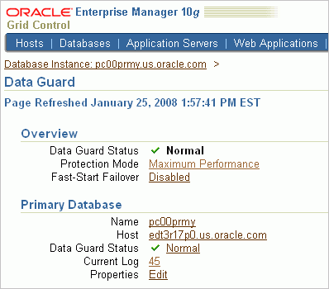
Using Enterprise Manager to Enable Fast-Start Failover
Click Disabled to invoke the fast-start failover wizard.
Notes:
Using Enterprise Manager to Enable Fast-Start Failover
On the Data Guard page, click the Disabled link (next to Fast-Start Failover) to invoke the fast-start failover wizard.

Slide 39
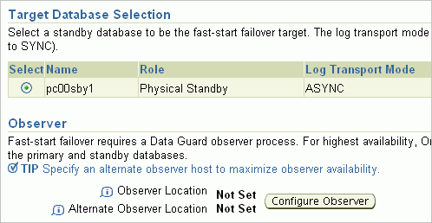
Using Enterprise Manager to Enable Fast-Start Failover
Select the database.
Click Configure Observer.
Notes:
Using Enterprise Manager to Enable Fast-Start Failover (continued)
Select the fast-start failover target database and (optional) the observer host. If the observer was not started, click the Configure Observer button.

Slide 40
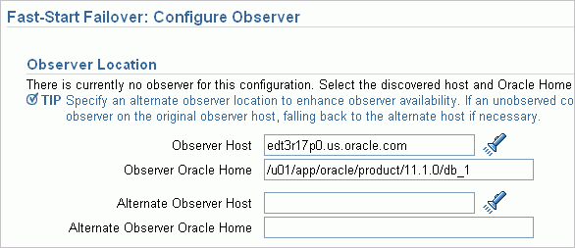
Using Enterprise Manager to Enable Fast-Start Failover
Notes:
Using Enterprise Manager to Enable Fast-Start Failover (continued)
Specify the observer host and observer Oracle home to indicate where the observer will be started.
Note: Enterprise Manager ensures that each observer has uniquely named data and DGMGRL log files. As a result, there is no problem if observers for different Data Guard configurations are started in the same Oracle Home.
The observer data files, named afoXXXXX.dat, are stored in the $ORACLE_HOME/dbs directory. The DGMGRL log file, named dgmgrlXXXXX.log, is stored in the $ORACLE_HOME/rdbms/log directory.
XXXXX is a unique number generated by Enterprise Manager and is the same for the observer data file and the DGMGRL log file for a given primary standby database configuration. XXXXX changes each time an observer is restarted.

Slide 41
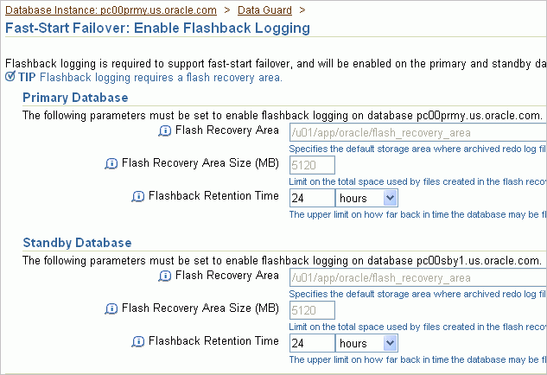
Using Enterprise Manager to Enable Fast-Start Failover
Notes:
Using Enterprise Manager to Enable Fast-Start Failover (continued)
Flashback logging must be enabled on both the primary database and the standby database to enable fast-start failover. If either database does not have flashback logging enabled, the Enable Flashback Logging page is displayed. Specify the flash recovery area location, flash recovery area size, and flashback retention time for each database.

Slide 42
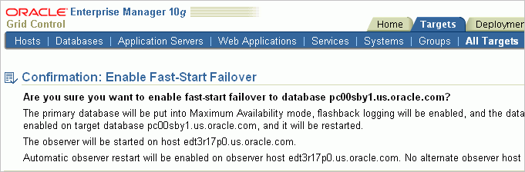
Using Enterprise Manager to
Enable Fast-Start Failover
Notes:
Using Enterprise Manager to Enable Fast-Start Failover (continued)
On the Confirmation: Enable Fast-Start Failover page, confirm that you want to enable fast-start failover to the named database.
Note: Enterprise Manager Grid Control 10g does not support maximum performance mode with fast-start failover.

Slide 43
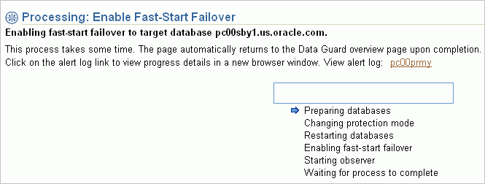
Using Enterprise Manager to Enable Fast-Start Failover
Notes:
Using Enterprise Manager to Enable Fast-Start Failover (continued)
After you confirm that you want to enable fast-start failover to a specific database, the fast-start enabling process begins. After the processing steps are complete, you are returned to the Data Guard page.
On the Data Guard Fast-Start Failover Processing page, you can observe the progress of the fast-start failover enabling operation as the following actions are performed:
Standby redo log files are created on the primary and standby databases.
The protection mode is upgraded to Maximum Availability (if required).
The primary database and standby database are restarted (if required).
Fast-start failover is enabled.
The observer process is started.

Slide 44
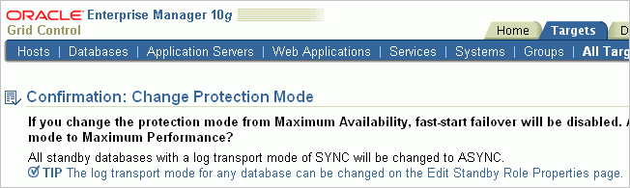
Changing the Protection Mode and Disabling Fast-Start Failover
Notes:
Changing the Protection Mode and Disabling Fast-Start Failover
If you change the protection mode to a mode that does not support fast-start failover, you implicitly disable fast-start failover.
Note: Enterprise Manager Grid Control 10g does not support maximum performance mode with fast-start failover.

Slide 45
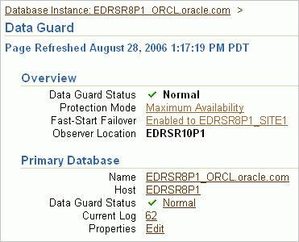
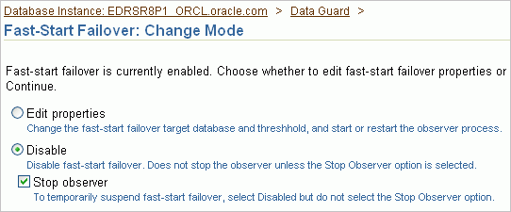
Using Enterprise Manager to
Disable Fast-Start Failover
Click the Enabled link to access the Change Mode page.
Notes:
Using Enterprise Manager to Disable Fast-Start Failover
Click the Enabled link to access the Fast-Start Failover: Change Mode page, where you select the Disable option and the “Stop observer” check box to disable fast-start failover.

Slide 46
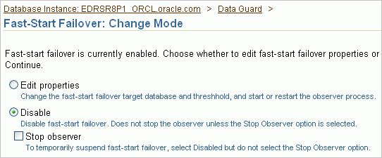
Using Enterprise Manager to
Suspend Fast-Start Failover
Notes:
Using Enterprise Manager to Suspend Fast-Start Failover
To suspend fast-start failover, select Disable on the Fast-Start Failover: Change Mode page. Do not select the “Stop observer” check box.

Slide 47
Moving the Observer to a New Host
To move the fast-start failover observer to a new host:
  Execute the STOP OBSERVER command to sever the link between the original observer and the broker configuration.
  Execute the SHOW CONFIGURATION VERBOSE and SHOW DATABASE commands to verify that the observer is stopped.
  Start the observer on your new host.
Notes:
Oracle Database 11g: Data Guard Administration 12 - <number>
Moving the Observer to a New Host
If the observer host machine fails, you may need to move the observer to a new host.
To stop the original observer and start the observer on a new host:
1. Execute the STOP OBSERVER command to sever the link between the original observer and the broker configuration:
DGMGRL> STOP OBSERVER;
2. Execute the SHOW CONFIGURATION VERBOSE and SHOW DATABASE commands to verify that the observer is stopped and the configuration is no longer being observed.
3. Invoke DGMGRL, connect to a database in your configuration, and start the observer on your new host.

Slide 48
Summary
In this lesson, you should have learned how to:
  Configure fast-start failover
  View information about the fast-start failover configuration
  Manage the observer
  Perform role changes in a fast-start failover configuration
  Manually reinstate the primary database
Notes:
Oracle Database 11g: Data Guard Administration 12 - <number>

Slide 49
Practice 12: Overview
This practice covers the following topics:
  Enabling fast-start failover
  Starting the observer
  Simulating a failure of the primary database and observing the fast-start failover operation
  Observing the automatic reinstatement of the new physical standby into the Data Guard configuration
  Switching back to your primary database
  Stopping the observer and disabling fast-start failover
Notes:
Oracle Database 11g: Data Guard Administration 12 - <number>

